Slide 1
Plan

Slide 2
Work and other Requirements
This project's largest task by some margin is found in the research, both for creating our simulator and for identifying promising compounds to simulate. We estimate that during the research period, we will be spending roughly 150 hours this semester, including the time already spent this semester.
Creating a simulator should take about 15 hours, once all the information required has been required.
This semester no simulations will take place, although actual simulation time once the simulator has been completed should be approximately 8 man hours.
Meetings are expected to take another 30 hours total this semester, although some less formal meetings may be classified in research.
This projects output will be simulated compounds and a simulator, and so the only other resources required are computers and information on compounds, which fortunately can be found online.

Slide 3
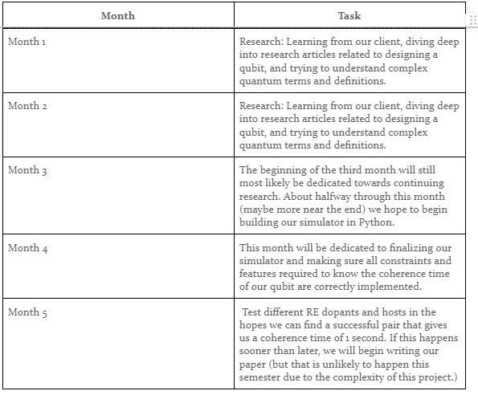
Task decomposition/Timetable
Tasks:
Research: both for compounds and to create a simulator
Develop simulator
Simulate various compounds
Possibly publish findings

Slide 4
Project Management Style
For our project, we will be adapting with the “waterfall” methodology. This is due to our project being able to be broken down into distinct phases of completion:
Research and gather information
Develop a simulator to test for coherence time
Test different Rare Earth dopants that work with a suitable host material
Our main form of communication has been through Discord, and we have been keeping track of progress and pooling our information through a Google Drive.

Slide 5
Project Proposed Milestones, Metrics, and Evaluation Criteria
The majority of this semester will be dedicated to learning/researching the quantum field and gaining a strong grasp of how the science works
Mission statement: Design a qubit with a coherence time of 1 second using a RE dopant and suitable host
Host material, Dopant material
Equations and relationships between material characteristics
Python coding
Results analysis
Sequence of events: Research, theorize, code, repeat

